Slide 1

Grover's Algorithm
Presented By – Harishankar Mishra
Quantum Algorithms using Qniverse . https://qniverse.in/

Slide 2

Problem Statement
Problem Statement: You are given a black-box function f(x) that takes a n-bit input and returns a single-bit output (either 0 or 1).
Task: Determine the input x for which the function returns 1.
Quantum Algorithms using Qniverse . https://qniverse.in/

Slide 3
Classical Approach
To determine the input for which the function returns 1, you need to check the output for each and every inputs
If for any input, the function returns 1, that input is the desired solution.
Time Complexity
For n-bit input, in the worst case, you need to evaluate 2^{n} inputs.
Limitations
As n grows, the number of evaluations grows exponentially, making the classical approach inefficient for large inputs.
Quantum Algorithms using Qniverse . https://qniverse.in/

Slide 4
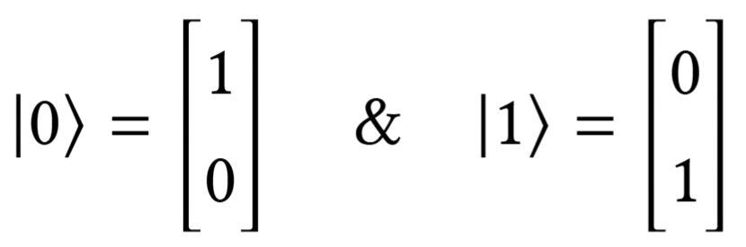
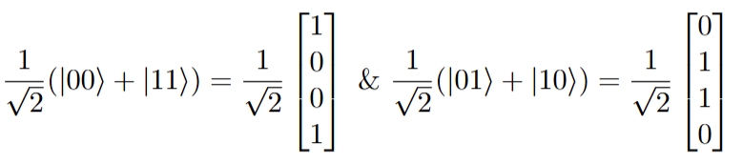
State Vector representation of quantum state
If we take an inner product of these two vectors we get 0.
Similarly if we consider these two states and take the inner product of their state vectors we get the solution as 0.
Thus, in both the case we conclude that the states are orthogonal.
Quantum Algorithms using Qniverse . https://qniverse.in/

Slide 5
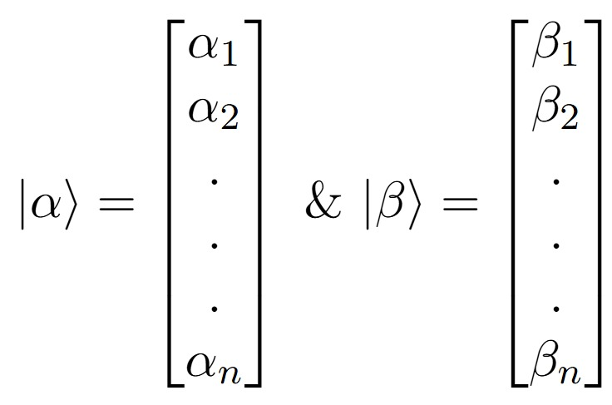

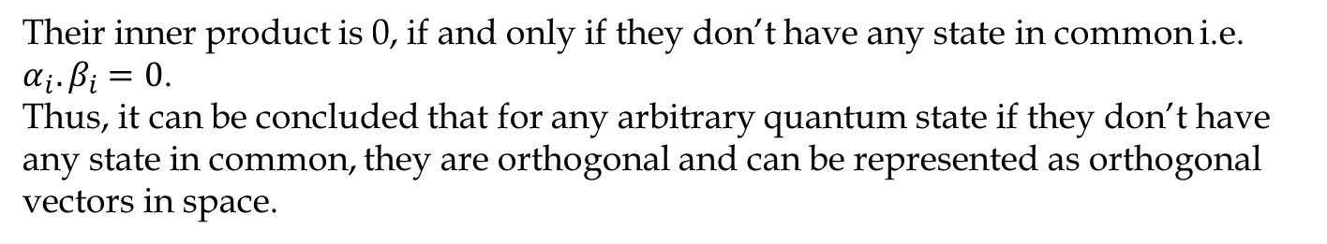
State Vector representation of quantum state
For these arbitrary vectors, their inner product is given by:
Their inner product is 0, if and only if they don’t have any state in common i.e. $α_{i}.β_{i}=0$.
Thus, it can be concluded that for any arbitrary quantum state if they don’t have any state in common, they are orthogonal and can be represented as orthogonal vectors in space.
Quantum Algorithms using Qniverse . https://qniverse.in/

Slide 6
Quantum Solution Grover's Algorithm
Quantum Algorithms using Qniverse . https://qniverse.in/

Slide 7
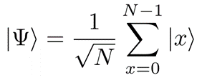
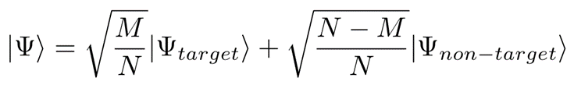
Grover's algorithm
Grover’s algorithm was designed to search target in an unsorted database. Alternatively, the problem statement can be understood as follows: consider a boolean function f(x) that takes an input x from N possibilities and returns a boolean value of 0 or 1. The objective of Grover’s algorithm is to find the input(s) x (target states) for which the function’s output is 1. Grover’s algorithm provides quadratic speedup over best known classical algorithm to solve the same problem.
Uniform Superposition of states, represented by:
This can be represented in terms of target and not-target states as:
M is the number of target states
Quantum Solution Grover's Algorithm
Quantum Algorithms using Qniverse . https://qniverse.in/

Slide 8
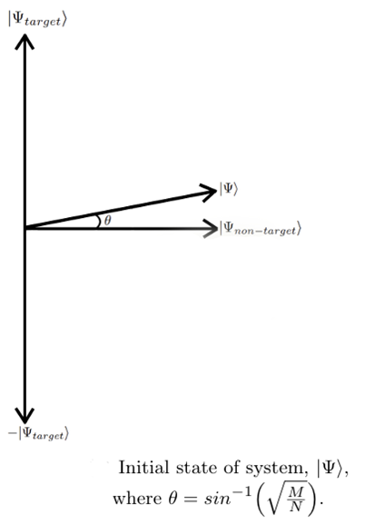
Grover's algorithm
Since the target states and the non-target states have no states in common, they can be represented as the orthogonal vectors. This is visualize as :
Quantum Solution Grover's Algorithm
Quantum Algorithms using Qniverse . https://qniverse.in/

Slide 9
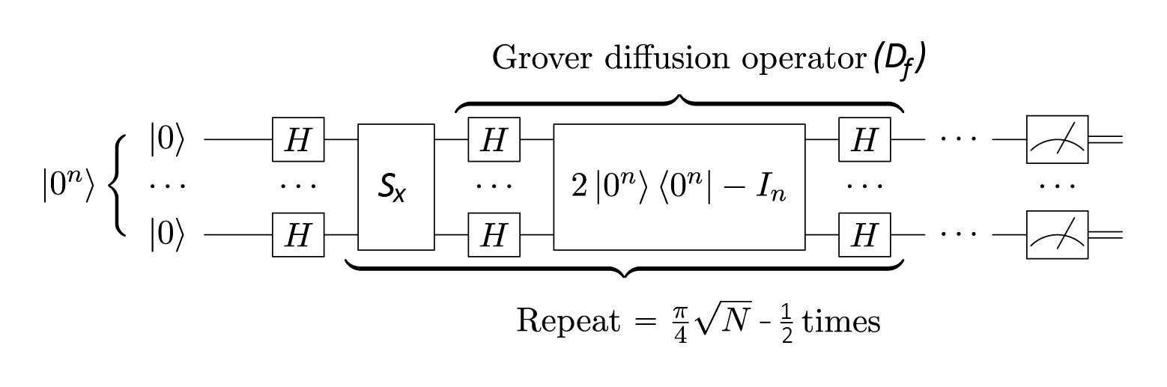
Grover's algorithm
The overall Grover’s operator is given by G=D_{f} S_{x}
S_{x} is the oracle that marks the target states by adding the phase of π. This can be visualize as the reflection of the current state of system about the non-target states.
D_{f} is the diffusion operator that amplifies the amplitude of the states marked by the oracle. This can be visualize as the reflection of the current state of system about the initial state of system.
Quantum Solution Grover's Algorithm
Quantum Algorithms using Qniverse . https://qniverse.in/

Slide 10
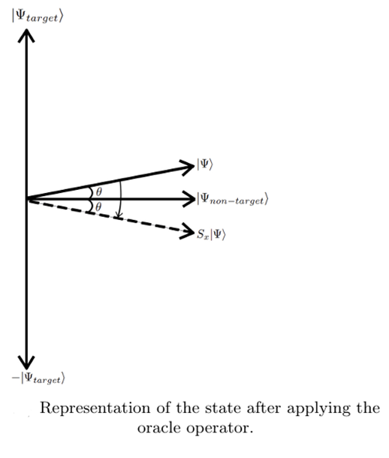
Grover's algorithm
Once the oracle is applied, the target gets a phase of pi. In this case the direction of the vector component of the state of the system along the target state is reversed. This state of system can be represented as :
Quantum Solution Grover's Algorithm
Quantum Algorithms using Qniverse . https://qniverse.in/

Slide 11
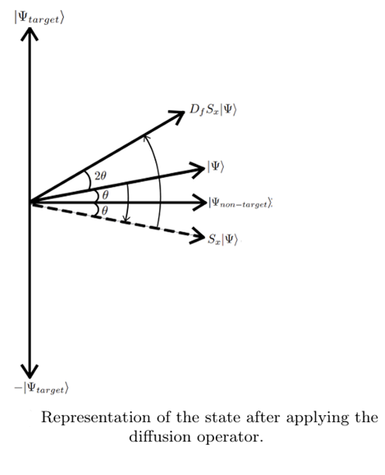
Grover's algorithm
The Grover diffusion operator is a reflection operator which when applied on after the oracle reflect the state of the system about the initial state of the system. This state of system is represented as :
Quantum Solution Grover's Algorithm
Quantum Algorithms using Qniverse . https://qniverse.in/

Slide 12
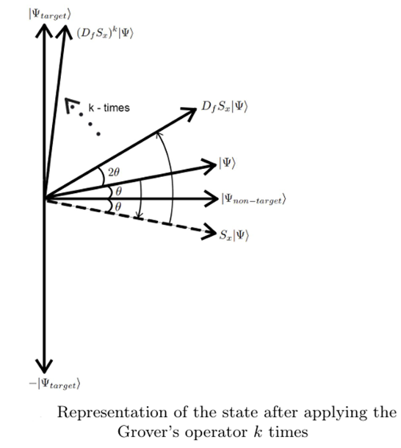
Grover's algorithm
As observed after a single application of Grover's operator the probability amplitude of the target state is increased as compared to that of the initial state. So we repeat this process k times to maximize the probability amplitude of the target states. This state of system is represented as :
Quantum Solution Grover's Algorithm
Quantum Algorithms using Qniverse . https://qniverse.in/

Slide 13
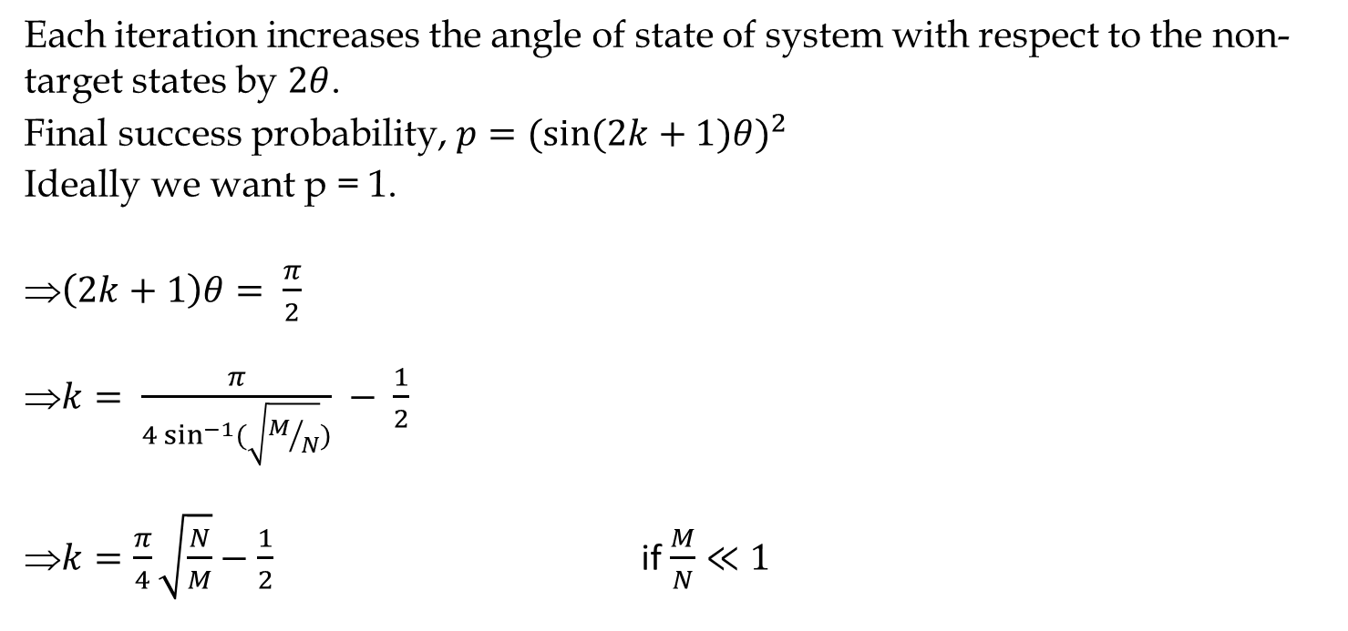
Quantum Solution Grover's Algorithm
Query Complexity
Quantum Algorithms using Qniverse . https://qniverse.in/

